Slide 1
Sponsors

Slide 2
A Research and Design Community
Making Technology Work for People

Slide 3
Welcome!

Slide 4
Announcements
Our guest speaker
CHI dessert

Slide 5
Thank you
to our new sponsor

Slide 6
Thank you
to our host

Slide 7
Who doesn’t love snacks?
Stay for networking and dessert
Pizza brought to you by
Dessert brought to you by

Slide 8
About BostonCHI
A non-profit, volunteer-run organization focused on Computer-Human Interaction.
Great speakers every time!
September – June
2nd Tuesday of the month… usually
Events with other Boston Interactions groups
Become a Member!
Annual membership only $15
Lifetime membership $150

Slide 9
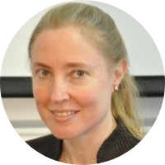
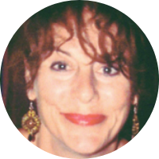
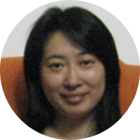
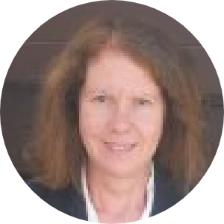
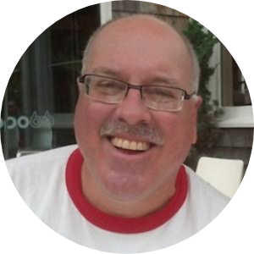
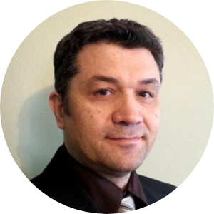
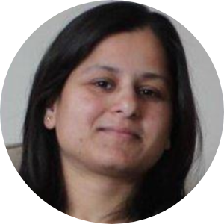
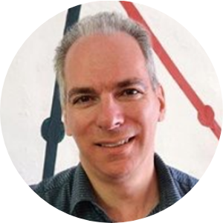
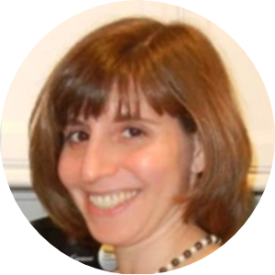
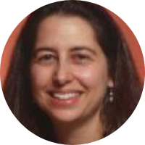
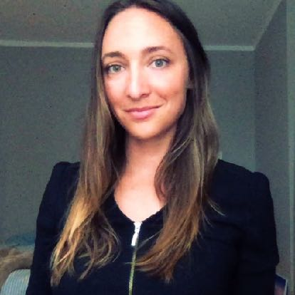
BostonCHI Steering Committee
Elizabeth
Todd
Michelle
Haijing
Wendy
Bill
Evo
Sampada
David
David
Rachel
Nicole
Sagan
We are always looking for people to help out!
Talk to one of us, or email: chair@BostonCHI.org

Slide 10
Hot Jobs — for members
More than 20 new jobs per month (WOW!)
Sign up at :
BostonCHI.org / hotjobs

Slide 11
Hiring?
And send any postings to hotjobs@bostonchi.org...
Raise your hand!

Slide 12
Looking?
Raise your other hand!!!

Slide 13
Other announcements?
Now’s your time to shine…

Slide 14
Save the date!
Annual Winter Boston Interactions Party!
Food and Drink
Appetizers and hors-d'oeuvres will be provided. There will be a cash bar.
The Asgard
350 Mass Ave.
(Between Central Sq. & MIT)
Cambridge
Tue, January 29, 2019, 6:00pm – 9:30pm

Slide 15
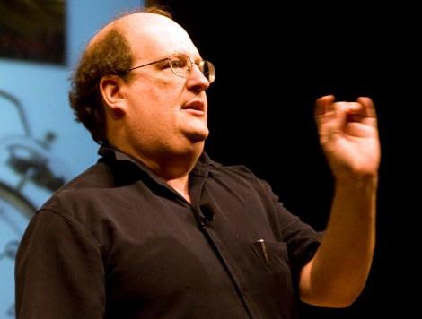
Next BostonCHI meeting
Thursday, Jan 17, 2019
Vistaprint
Why Is Hiring Great UX Professionals So Damn Challenging?
Jared Spool
Centre Center

Slide 16
Please turn off, or use silent mode
(thank you!)

Slide 17
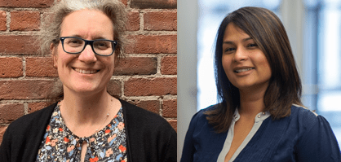
Dana Ortegón & Priyama Bari
Mad*Pow
Agile Behavior-Based Personas for Better Designs

Slide 18
A Research and Design Community
Making Technology Work for People

